Slide 1
HPC final project
Agnese Valentini
Mat. SM3600013

Slide 2



Aim of the project
Hybrid parallelization of 5 point stencil method using MPI and OpenMP
Run scaling tests on Leonardo supercomputer

Slide 3
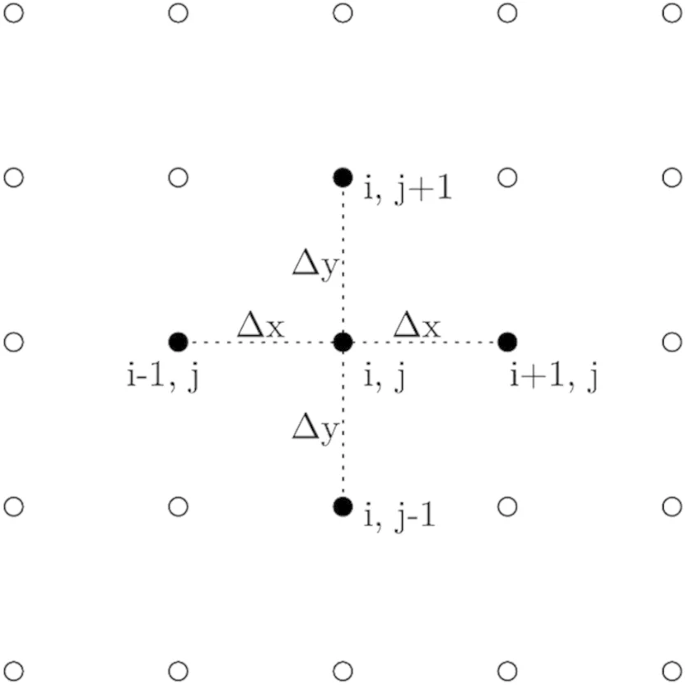
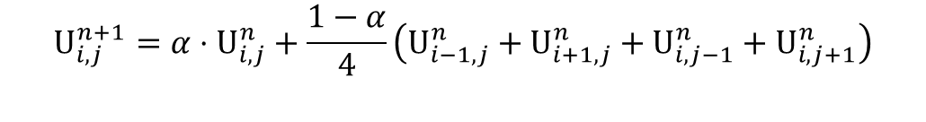
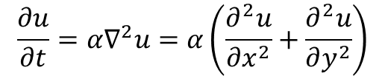
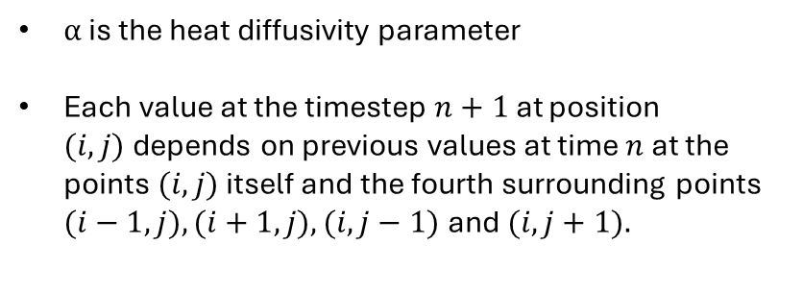
Discretization of the 2D heat equation
$$\frac{∂u}{∂t}=α∇^{2}u=α\left(\frac{∂^{2}u}{∂x^{2}}+\frac{∂^{2}u}{∂y^{2}}\right)$$
Time discretization: forward Euler method
Space discretization: central finite differences
$$U_{i,j}^{n+1}=α⋅U_{i,j}^{n}+\frac{1−α}{4}\left(U_{i−1,j}^{n}+U_{i+1,j}^{n}+U_{i,j−1}^{n}+U_{i,j+1}^{n}\right)$$
$α$ is the heat diffusivity parameter
Each value at the timestep $n+1$at position $(i,j)$depends on previous values at time $n$ at the points$(i,j)$itself and the fourth surrounding points $(i−1,j), (i+1,j), (i,j−1)$and$(i,j+1).$
Picture taken from Sharma, Mittra, A finite‐difference‐based technique for numerically efficient computation of capacitance matrices for 2‐dimensional multi‐conductor problems involving thin dielectric coating, June 2024 International Journal of Numerical Modelling Electronic Networks Devices and Fields 37(4)

Slide 4
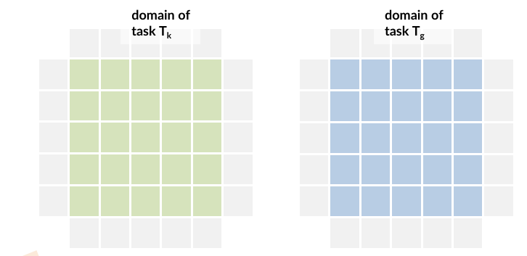
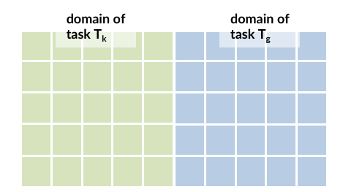
MPI – domain decomposition and memory allocation
Communicating buffers
North/south: no separate buffers allocated, rows contiguous in memory, direct pointers to first/last rows
West/east: explicit buffers allocated because columns are non-contiguous
Allocate two planes: OLD and NEW
Each plane size: (mysize[x] + 2) × (mysize[y] + 2) doubles to account for halo regions
Both planes are initialised to zero with memset()

Slide 5
MPI – parallelization
Halo regions exchanged using non blocking MPI_Isend/MPI_Irecv
Stencil update into two phases:
update_plane_internal updates all grid points not adjacent to boundaries and executes during MPI communication
update_plane_boundary updates only the outer layer of grid points and is executed after halo exchange completes (MPI_Waitall)

Slide 6
OpenMP – parallelization
#pragma omp for schedule(static): static is supposed to be most effective when each iteration brings the same computational work
#pragma omp parallel for collapse(2) reduction(+:totenergy):
collapse enables the parallelization of multiple loops level
reduction (+:totenergy):

Slide 7
Input size for the tests

Slide 8
Multithread scaling

Slide 9
Strong scaling

Slide 10
Weak scaling

Slide 11
Conclusions

